Slide 1


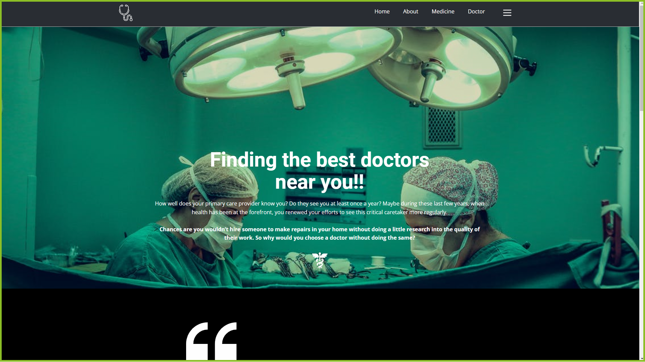
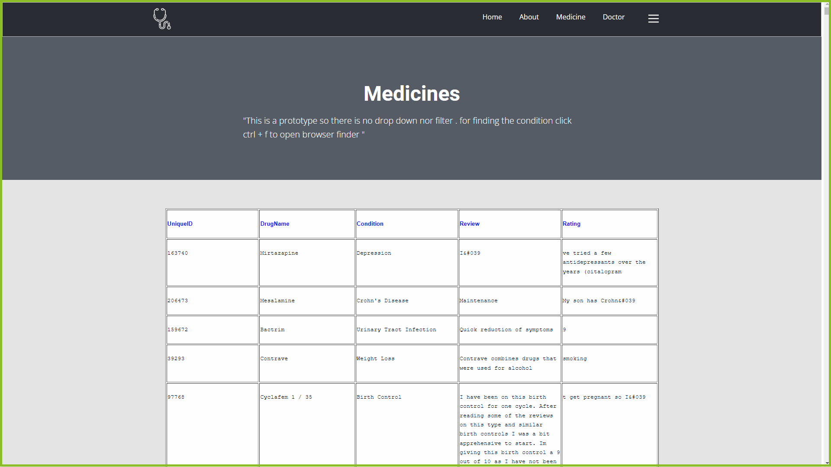
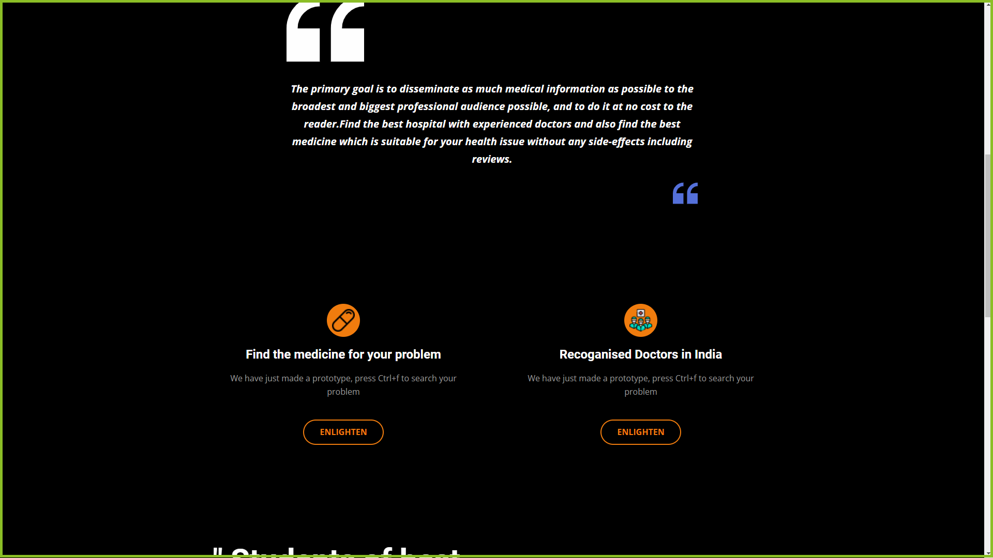
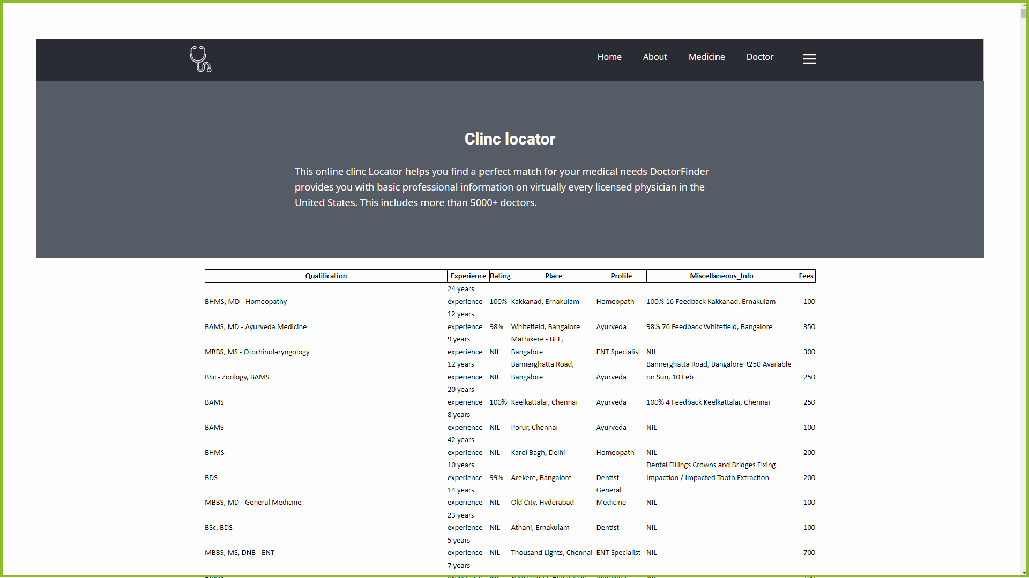
AbSTRACT
Problem definition
MEDSCAPE
The primary goal is to disseminate as much medical information as possible to the broadest and biggest professional audience possible, and to do it at no cost to the reader.Find the best hospital with experienced doctors and also find the best medicine which is suitable for your health issue without any side-effects including reviews.
An app to locate the best doctors near your home and find the best medicines according to your health problem.
Implementation
Quick access to best doctors
Quick access to best medicine
Rating
experience
Open/close times of hospital
Price history
Payment methods
Day to day uses
In day-to-day life, we experience many health issues. We believe whatever doctor says without knowing the doctor’s experience, knowledge etc . In order to give best health-care ,we should ensure good medicines and good doctors who are much experts and be useful for the people.
P
R
O
T
O
T
Y
P
E

